Slide 1
COVID-19
This Photo by Unknown author is licensed under CC BY-SA.
AKA "Corona Virus"

Slide 2
Today we are going to talk about this Virus that has the world upside down. What are some of the things you've heard or know? Let's clear the air and get the real facts.

Slide 3
What is COVID-19
COVID-19 is a respiratory illness that can spread from person to person. This is what health educators and professionals refer to as a "Communicable Disease."
It was first identified through an outbreak in Wuhan, China.
https://www.cdc.gov/coronavirus/2019-nCoV/index.html

Slide 4
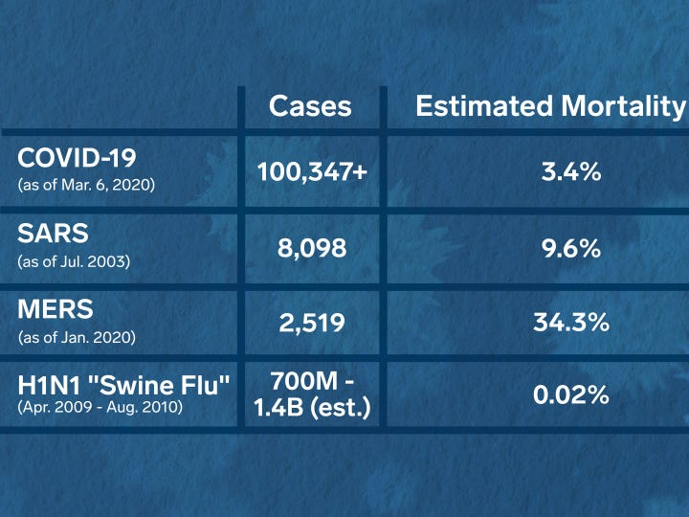
Important Reminder: WE HAVE DONE THIS BEFORE!!!!
Severe Acute Respiratory Syndrom (SARS) - contained within 6 months
https://www.businessinsider.com/coronavirus-compared-to-sars-swine-flu-mers-zika-2020-3

Slide 5
Why do we call it "Corona Virus?"
Corona in Latin means Crown.
Because of its crown-like cell projections.
This Photo by Unknown author is licensed under CC BY-SA.

Slide 6
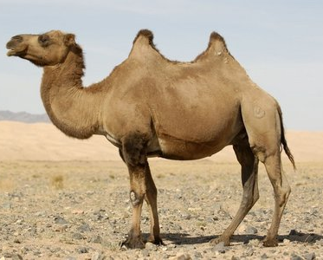
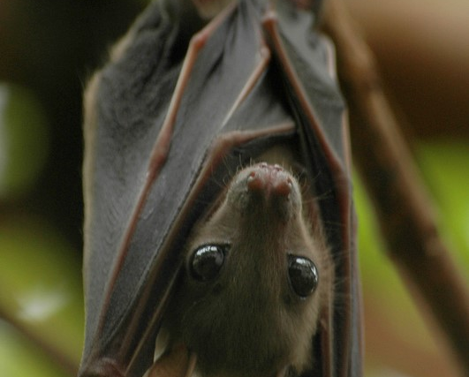
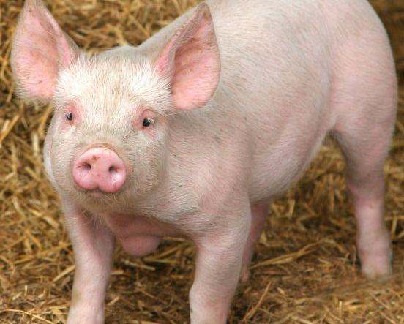
Source
Majority of epidemic and pandemic virus have a zoonotic source.
Severe Acute Respiratory Syndrome (SARS) stemmed from Bats
Middle East Respiratory Syndrome (MERS) stemmed from Camels
Swine Influenza (Swine Flu) stemmed from Pigs
This Photo by Unknown author is licensed under CC BY-NC-ND.
This Photo by Unknown author is licensed under CC BY-NC-ND.
https://www.who.int/ith/diseases/sars/en/

Slide 7
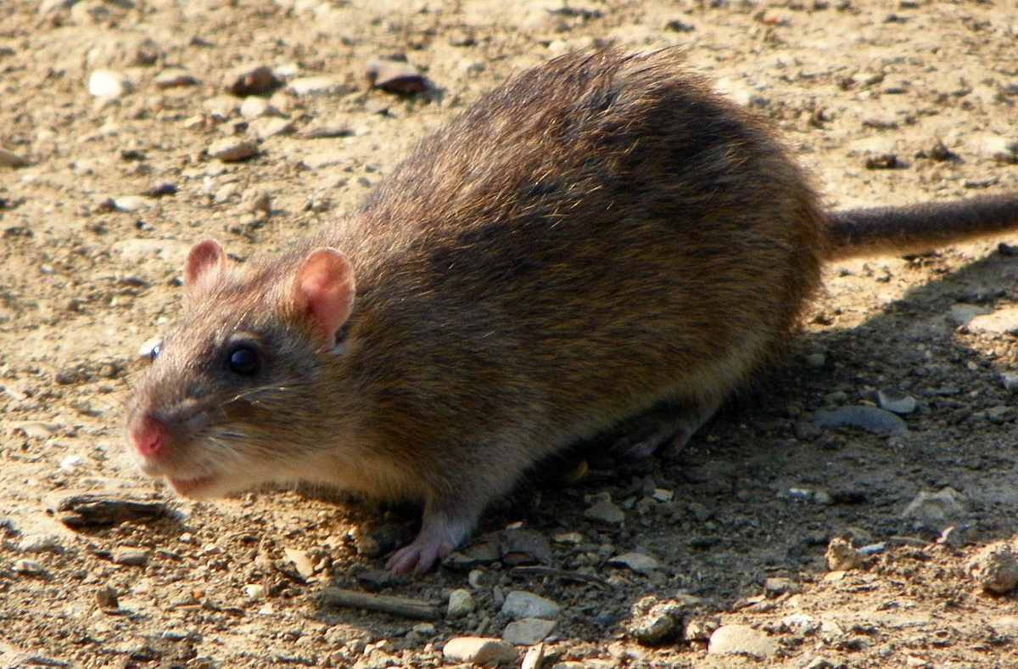
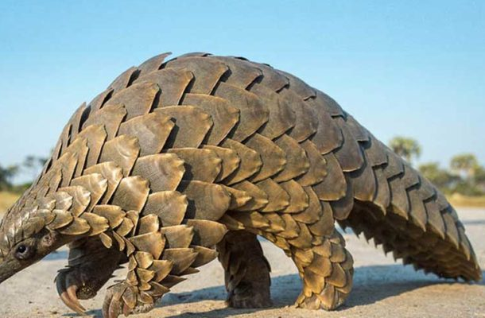
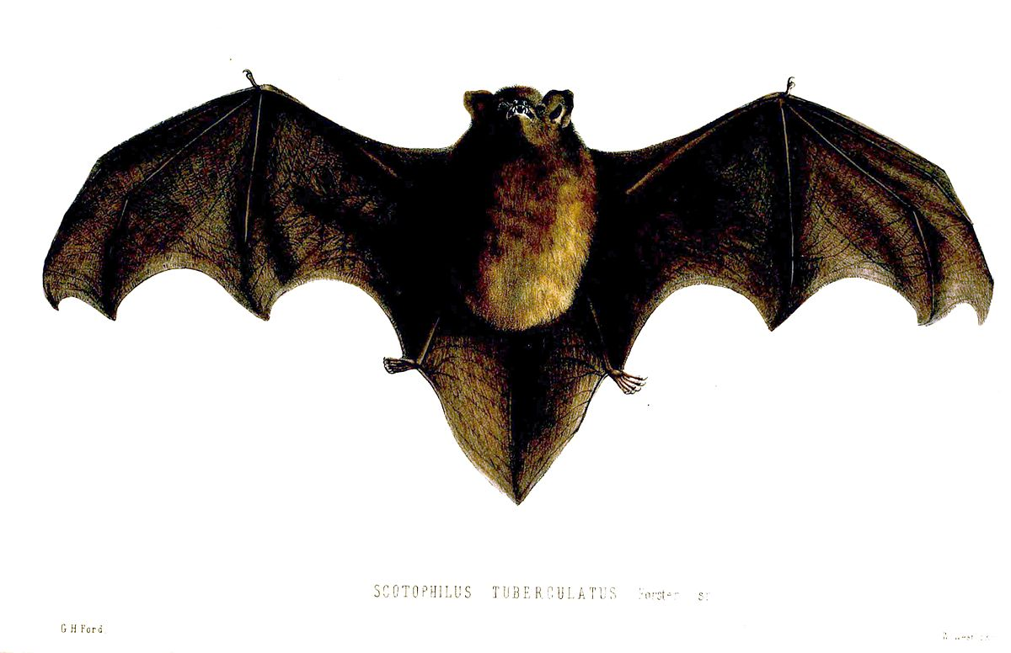
These are some potential sources of Covid-19
This Photo by Unknown author is licensed under CC BY-SA.
In China, 66% of initial Covid-19 cases had direct exposure to the Huanan Seafood Market.
These 3 animals were found to be possible carriers...
This Photo by Unknown author is licensed under CC BY-SA.
This Photo by Unknown author is licensed under CC BY-SA.

Slide 8
The virus emerged from an animal and now spreading from person to person.
The virus is spread between people who are in close contact (within about 6 feet)
Majority is spread through respiratory droplets produced when a person coughs or sneezes.
HOWEVER … we touch everything!

Slide 9
Where are we with the spread of COVID-19?
Sporadic – occur rarely and don’t have a geographic focus
Endemic – occur within a population
Epidemic – occur within a country
Pandemic – global outbreak

Slide 10
Map of covid-19 Spread
https://gisanddata.maps.arcgis.com/apps/opsdashboard/index.html#/bda7594740fd40299423467b48e9ecf6

Slide 11
Why are we freaking out?!?

Slide 12
We have a target population that we are trying to protect.

Slide 14
What Can you do?
Be aware of the symptoms. Fever. Cough. Shortness of Breath.
Avoid contact with people who are sick.
Avoid touching your eyes, nose and mouth with un-washed hands.
Wash Hands often.

Slide 15
Why the social distancing?
There is not currently a vaccine to protect against covid-19. Right now, the best defense is to practice preventative actions.
Additionally, there is no treatment for Covid-19.

Slide 16
Reasons Youthcare students should feel safe:
Youthcare is taking precaution. Not just to protect you but your loved ones.
You have 24/7 medical attention. If symptoms arise, we can combat them fast.
You, your staff, your teachers, your therapists will make sure you are clean!

Slide 17
If you would like more information, I recommend Johns Hopkins Medicine or the CDc.
https://www.cdc.gov/coronavirus/2019-ncov/about/index.html
https://coronavirus.jhu.edu/
Johns Hopkins updates their site more frequently.

Slide 18
Sources Cited:
https://www.cdc.gov/coronavirus/2019-nCoV/index.html
https://coronavirus.utah.gov/
http://www.cidrap.umn.edu/covid-19/maps-visuals
https://economictimes.indiatimes.com/news/international/world-news/covid-19-outbreak-mers-sars-had-higher-fatality-rates/articleshow/74467911.cms
https://www.nature.com/articles/d41586-020-00548-w
https://www.cdc.gov/coronavirus/2019-ncov/prepare/animals.html

